Slide 1
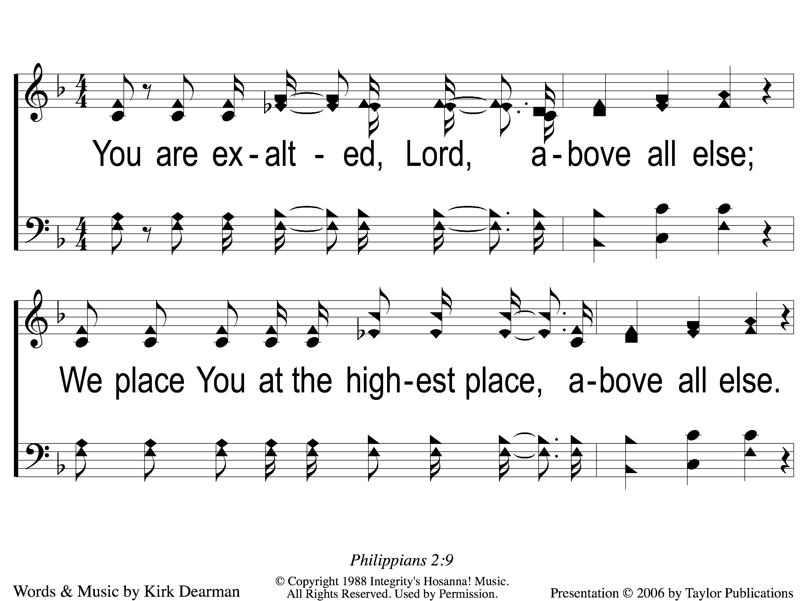
1 Above All Else
Above All Else
171

Slide 2
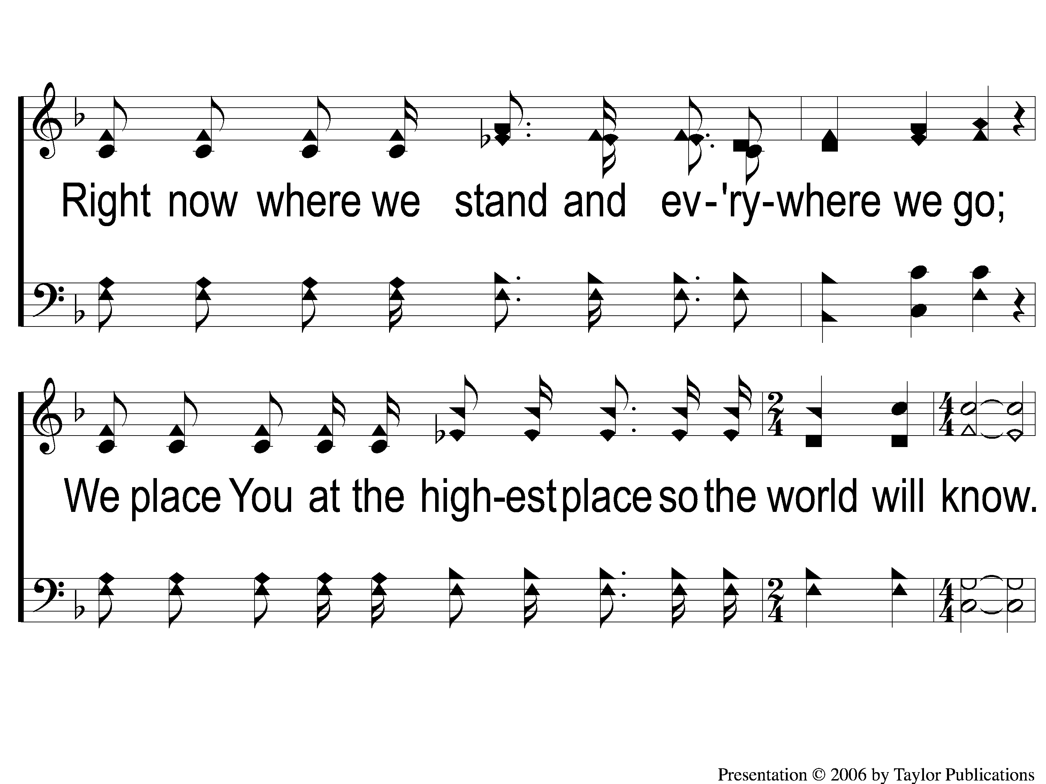
2 Above All Else
Above All Else
171

Slide 3
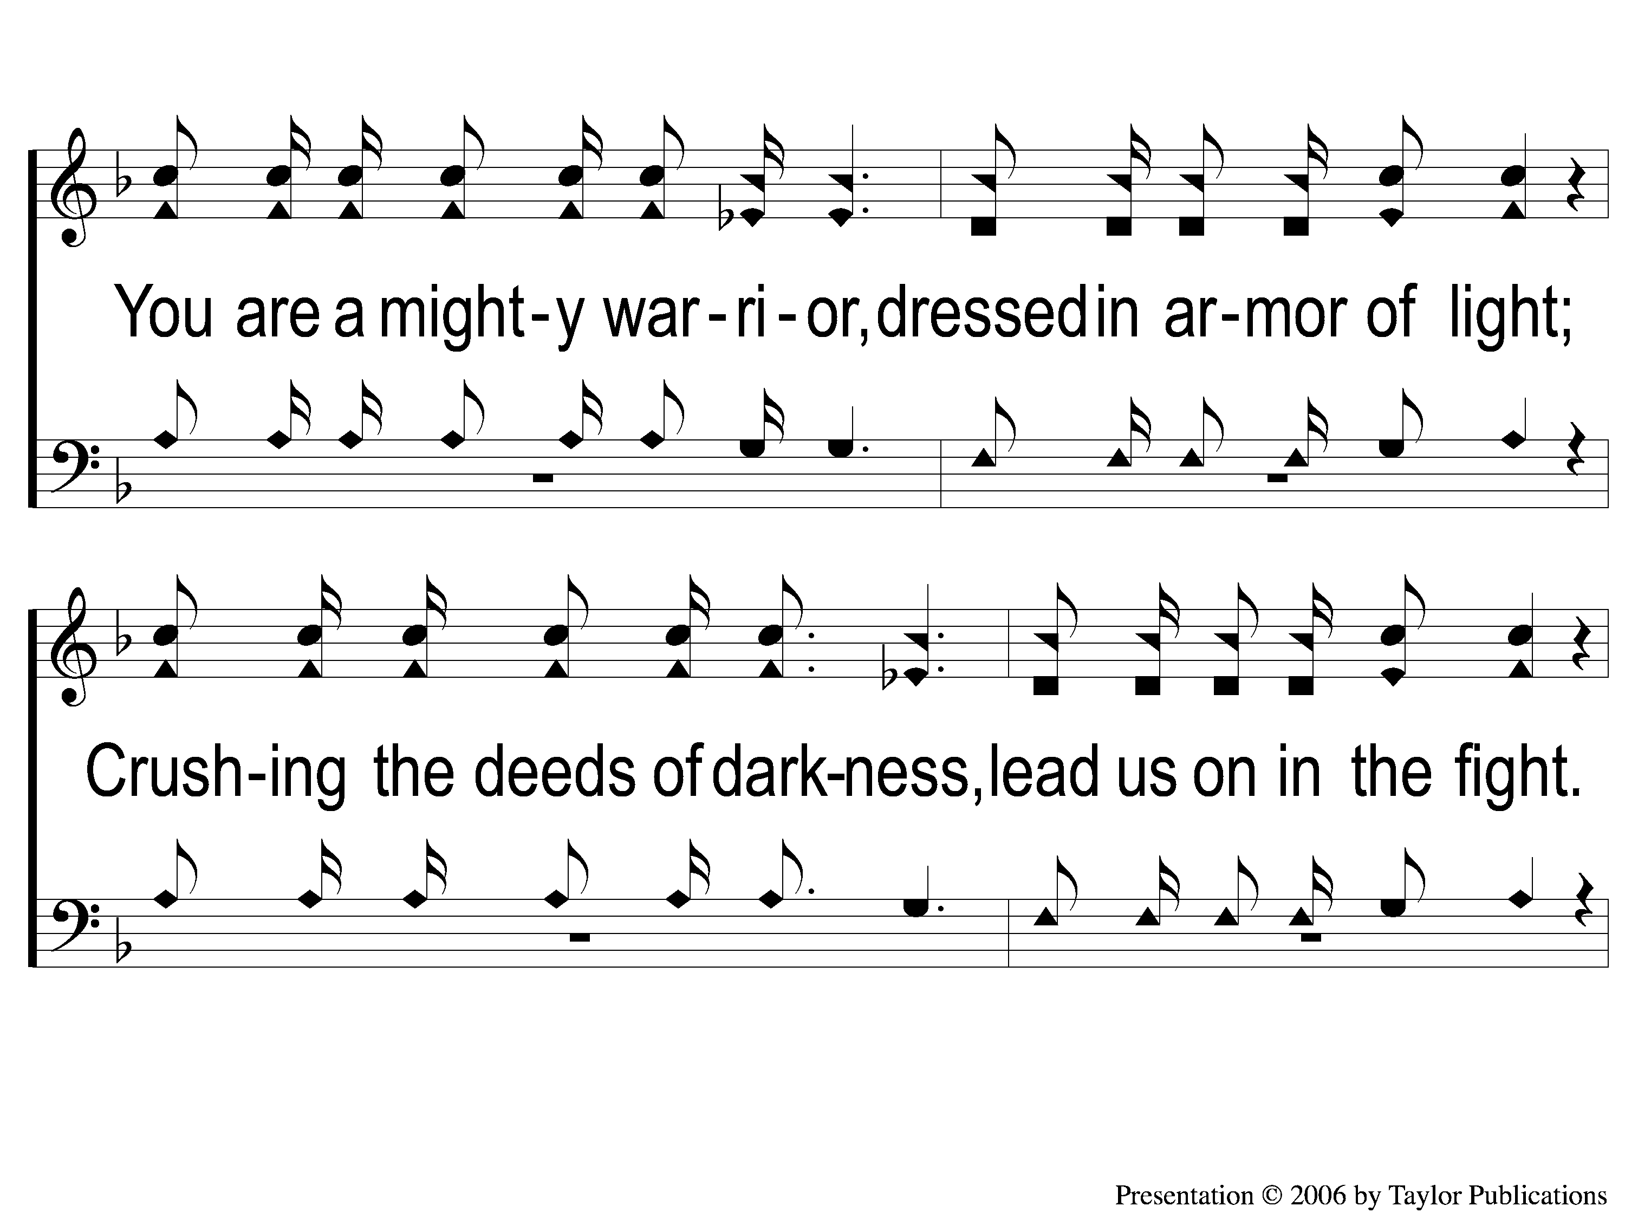
3 Above All Else
Above All Else
171

Slide 4
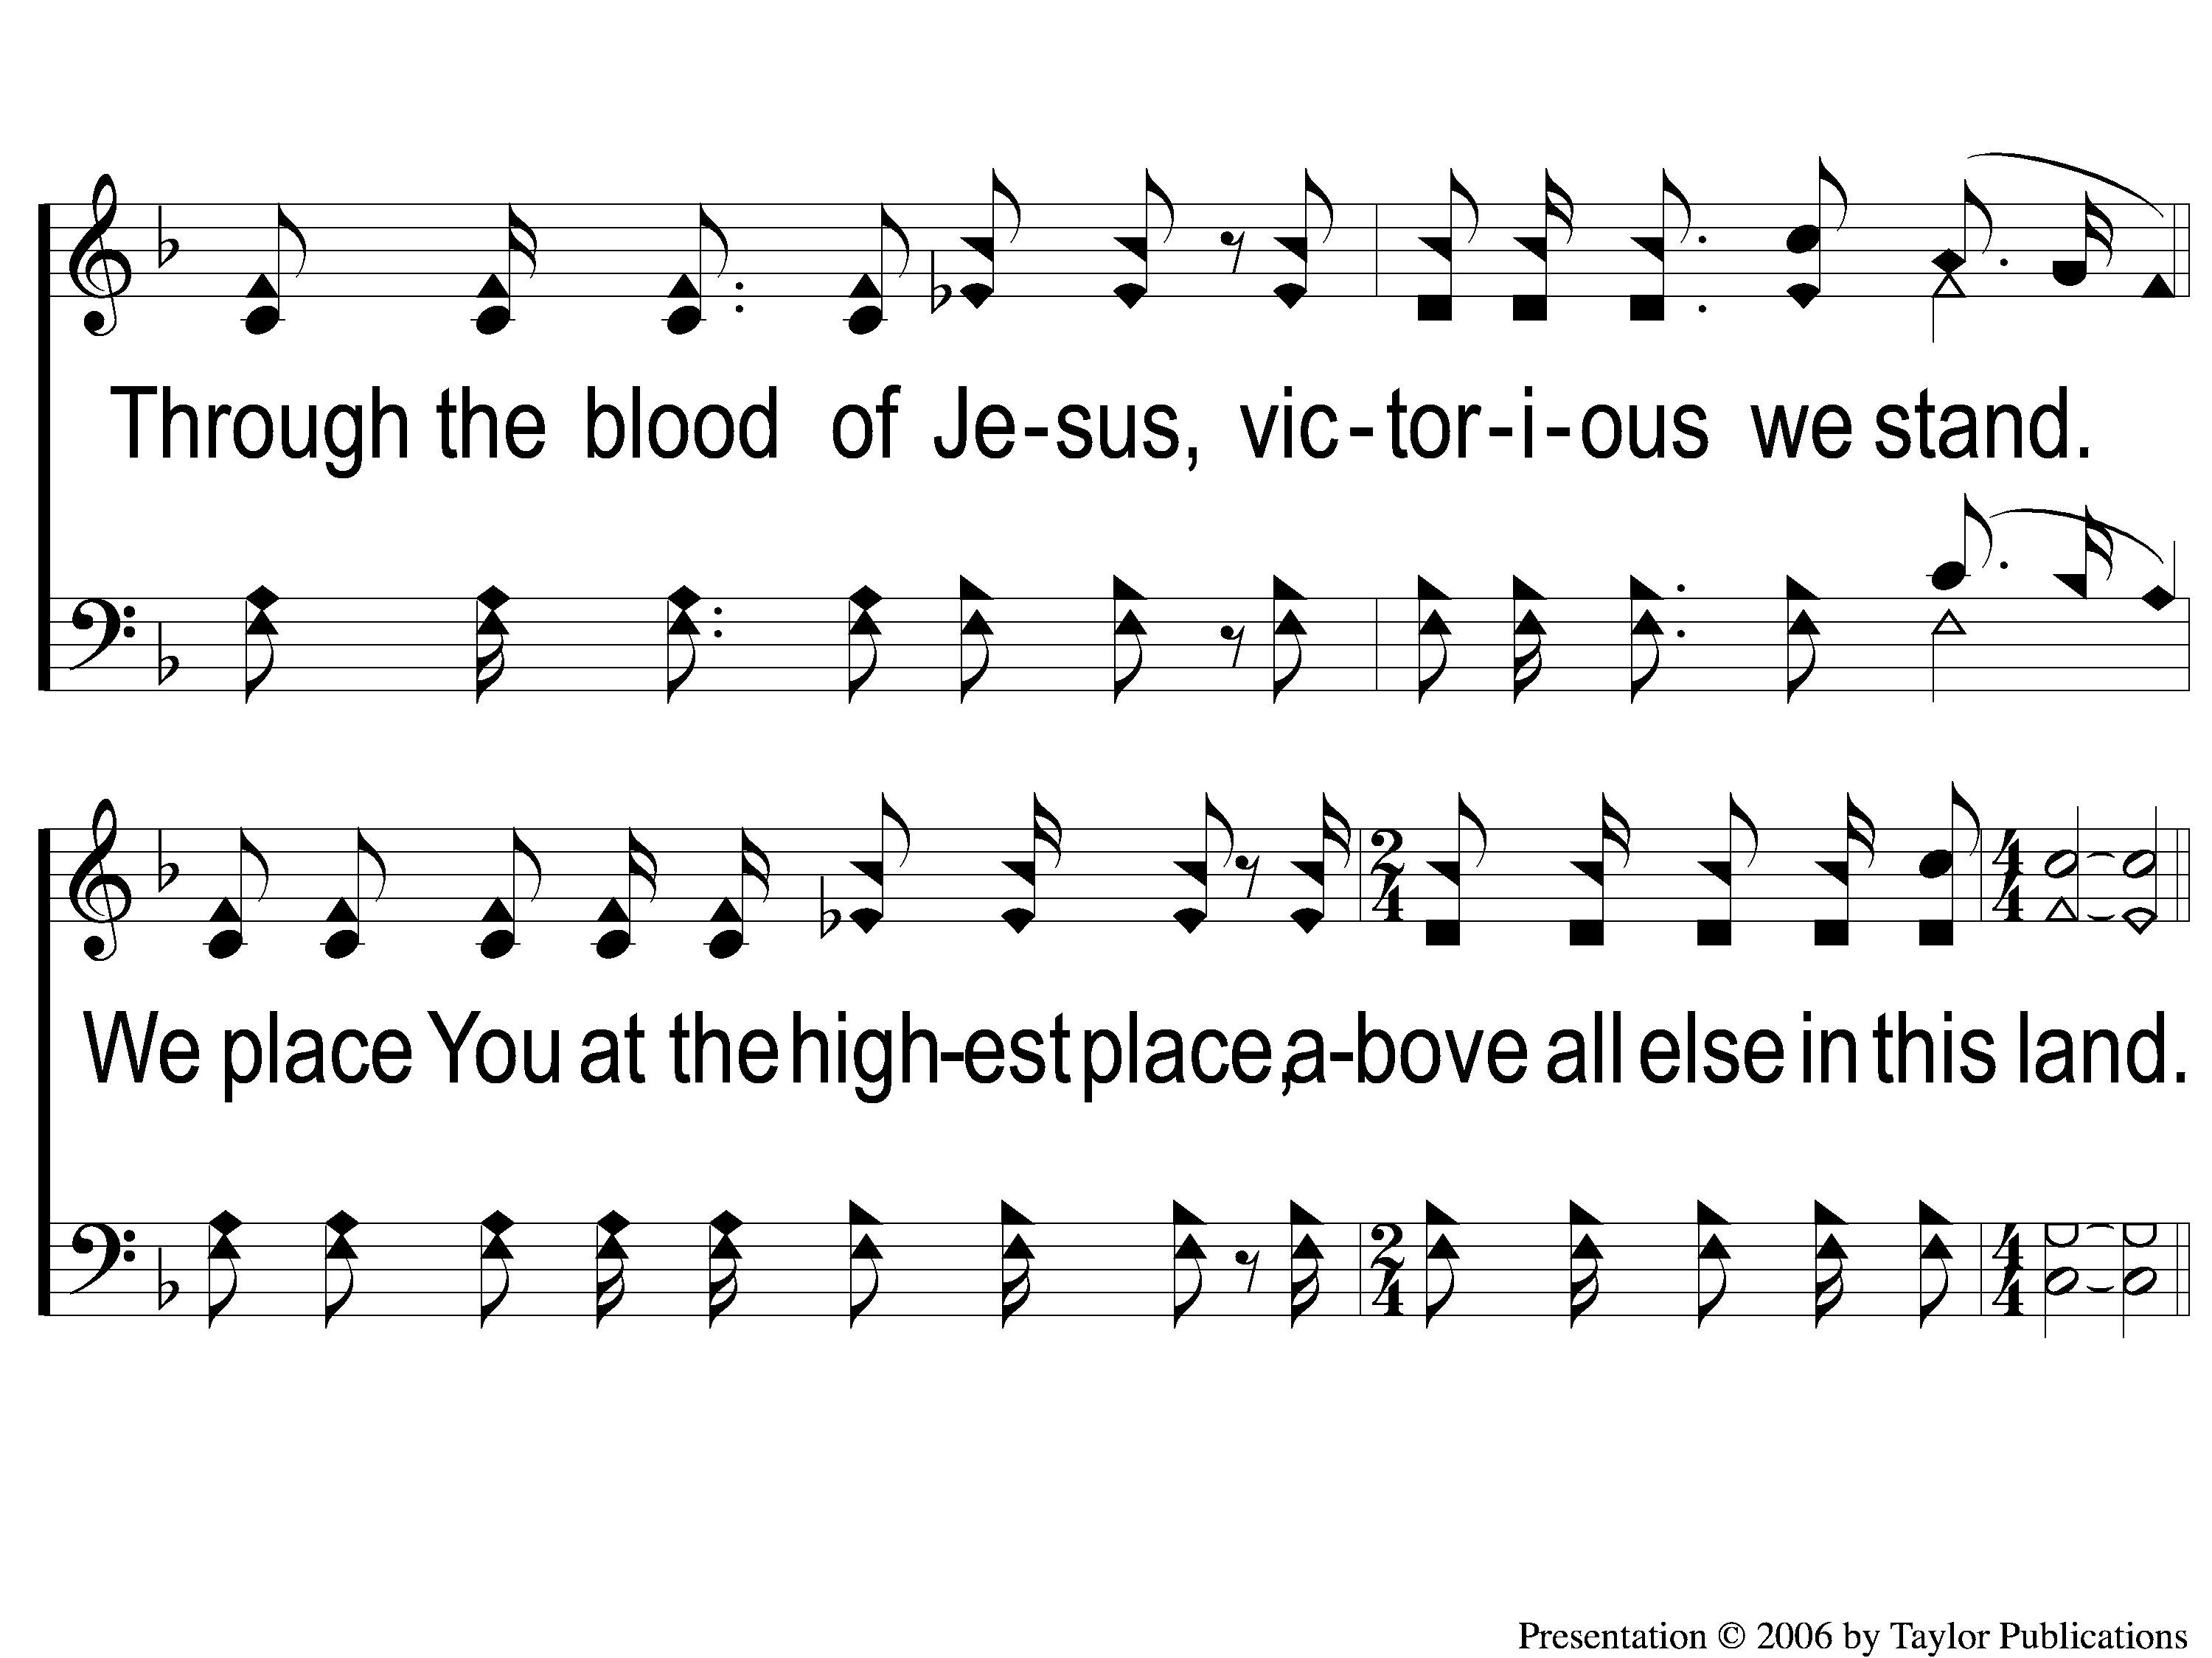
4 Above All Else
Above All Else
171

Slide 5
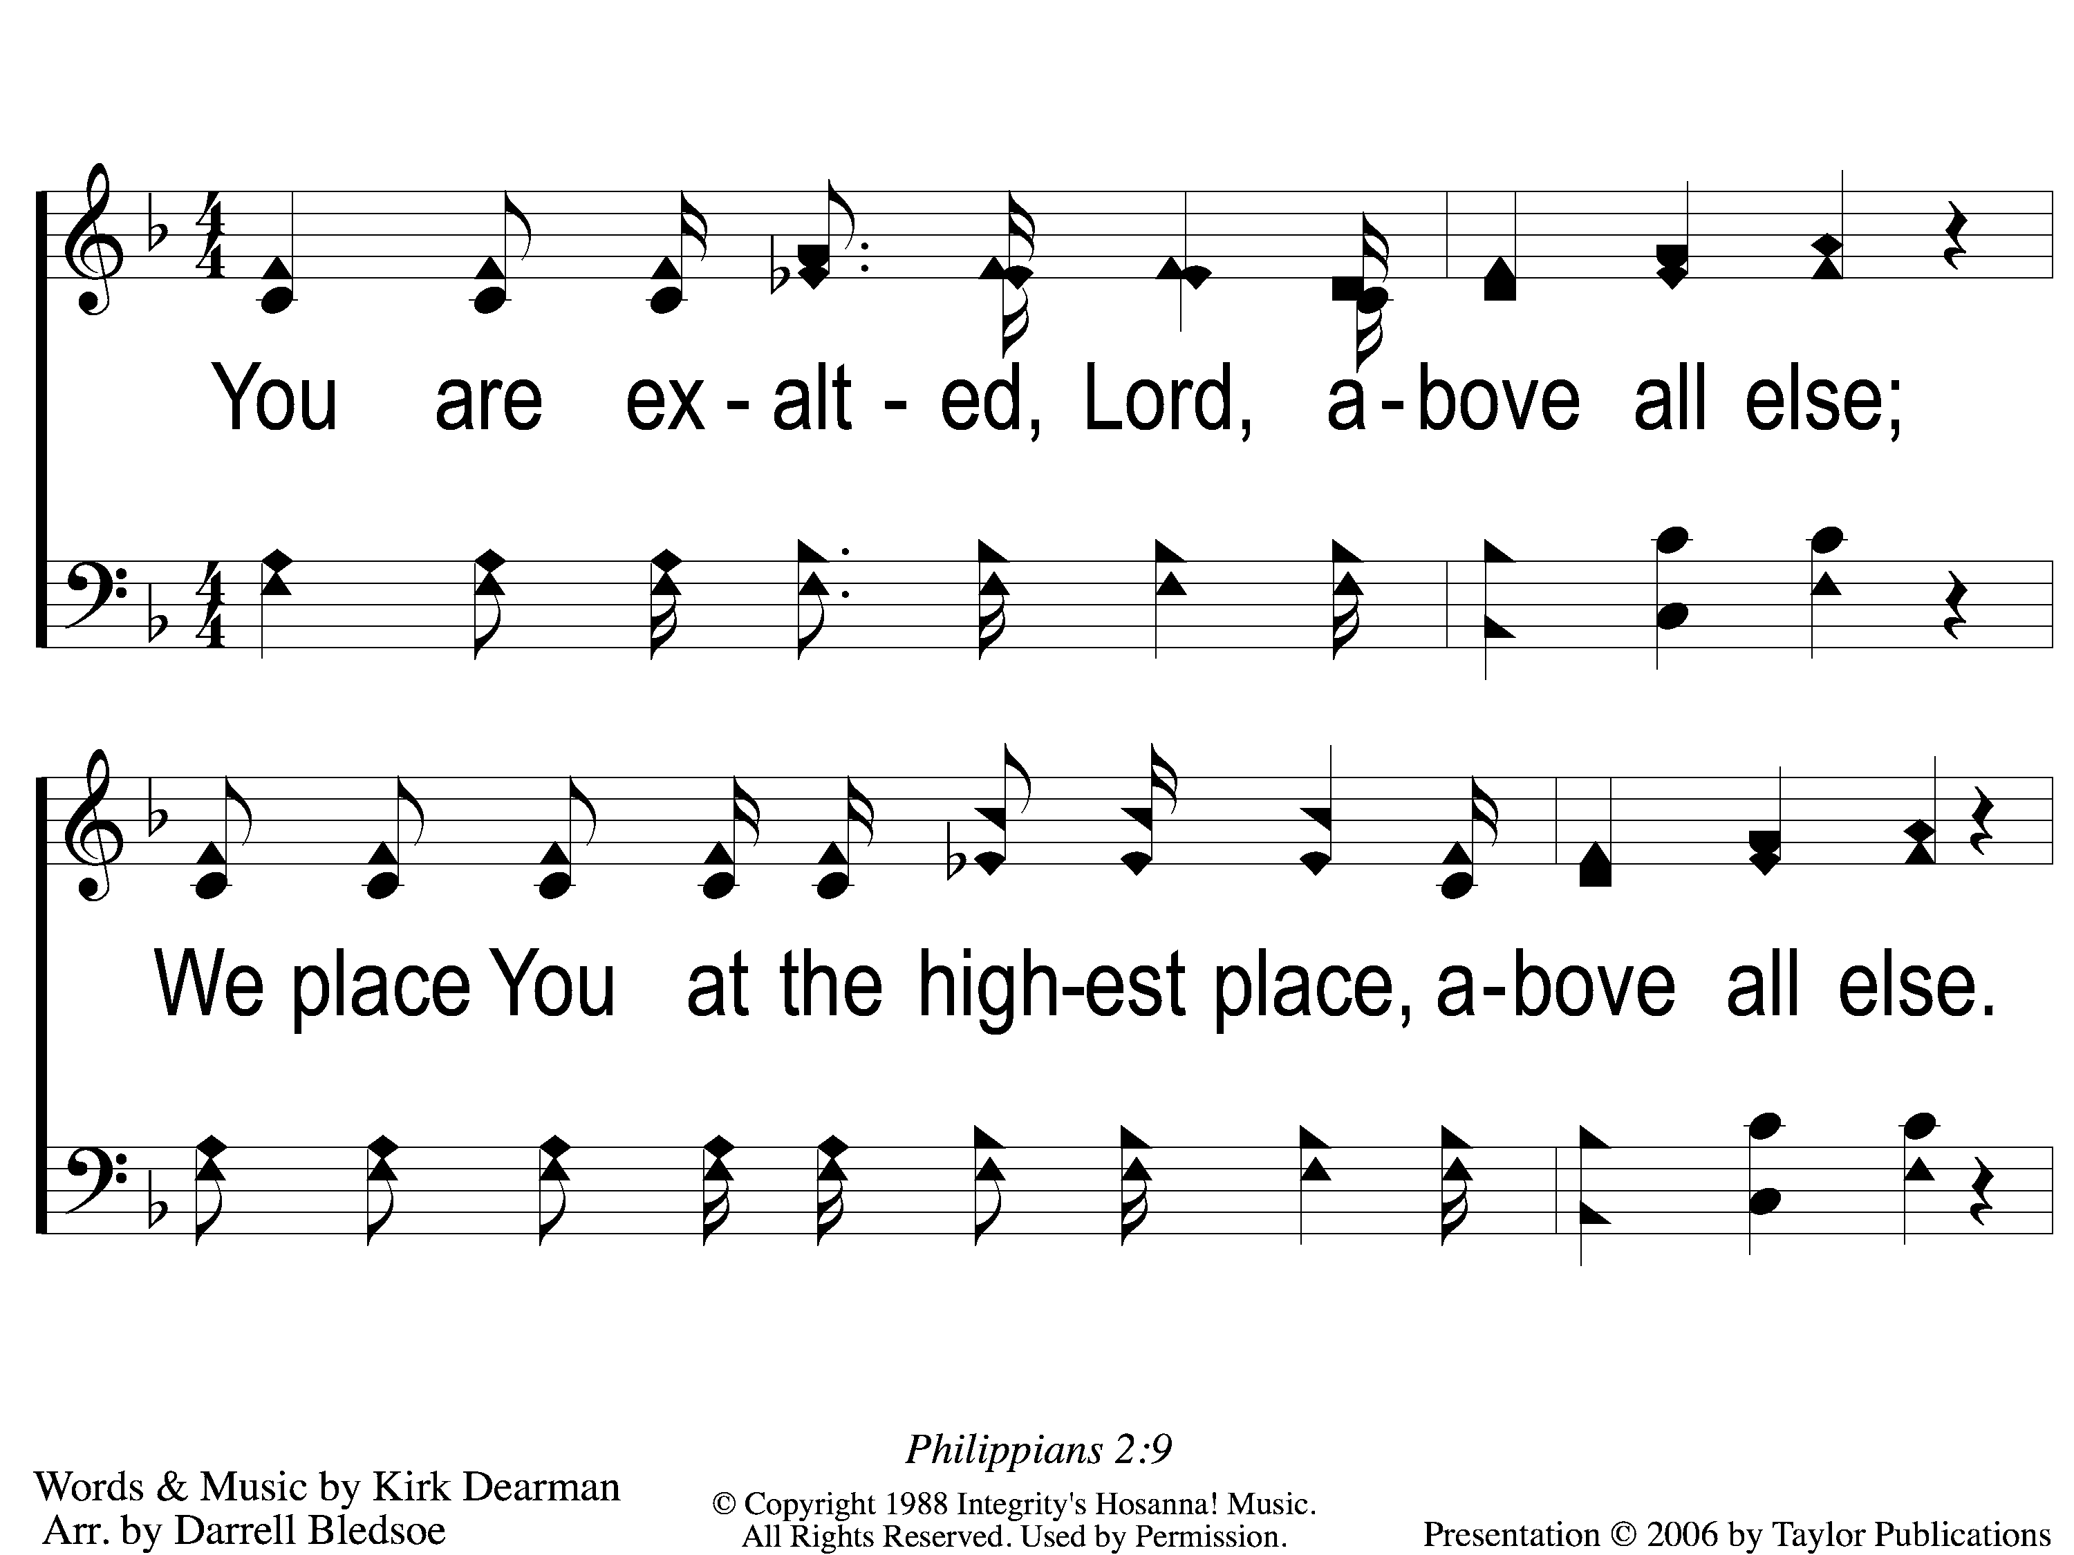
1 Above All Else
Above All Else
171

Slide 6
2 Above All Else
Above All Else
171

Slide 7
3 Above All Else
Above All Else
171

Slide 8
4 Above All Else
Above All Else
171

Slide 9
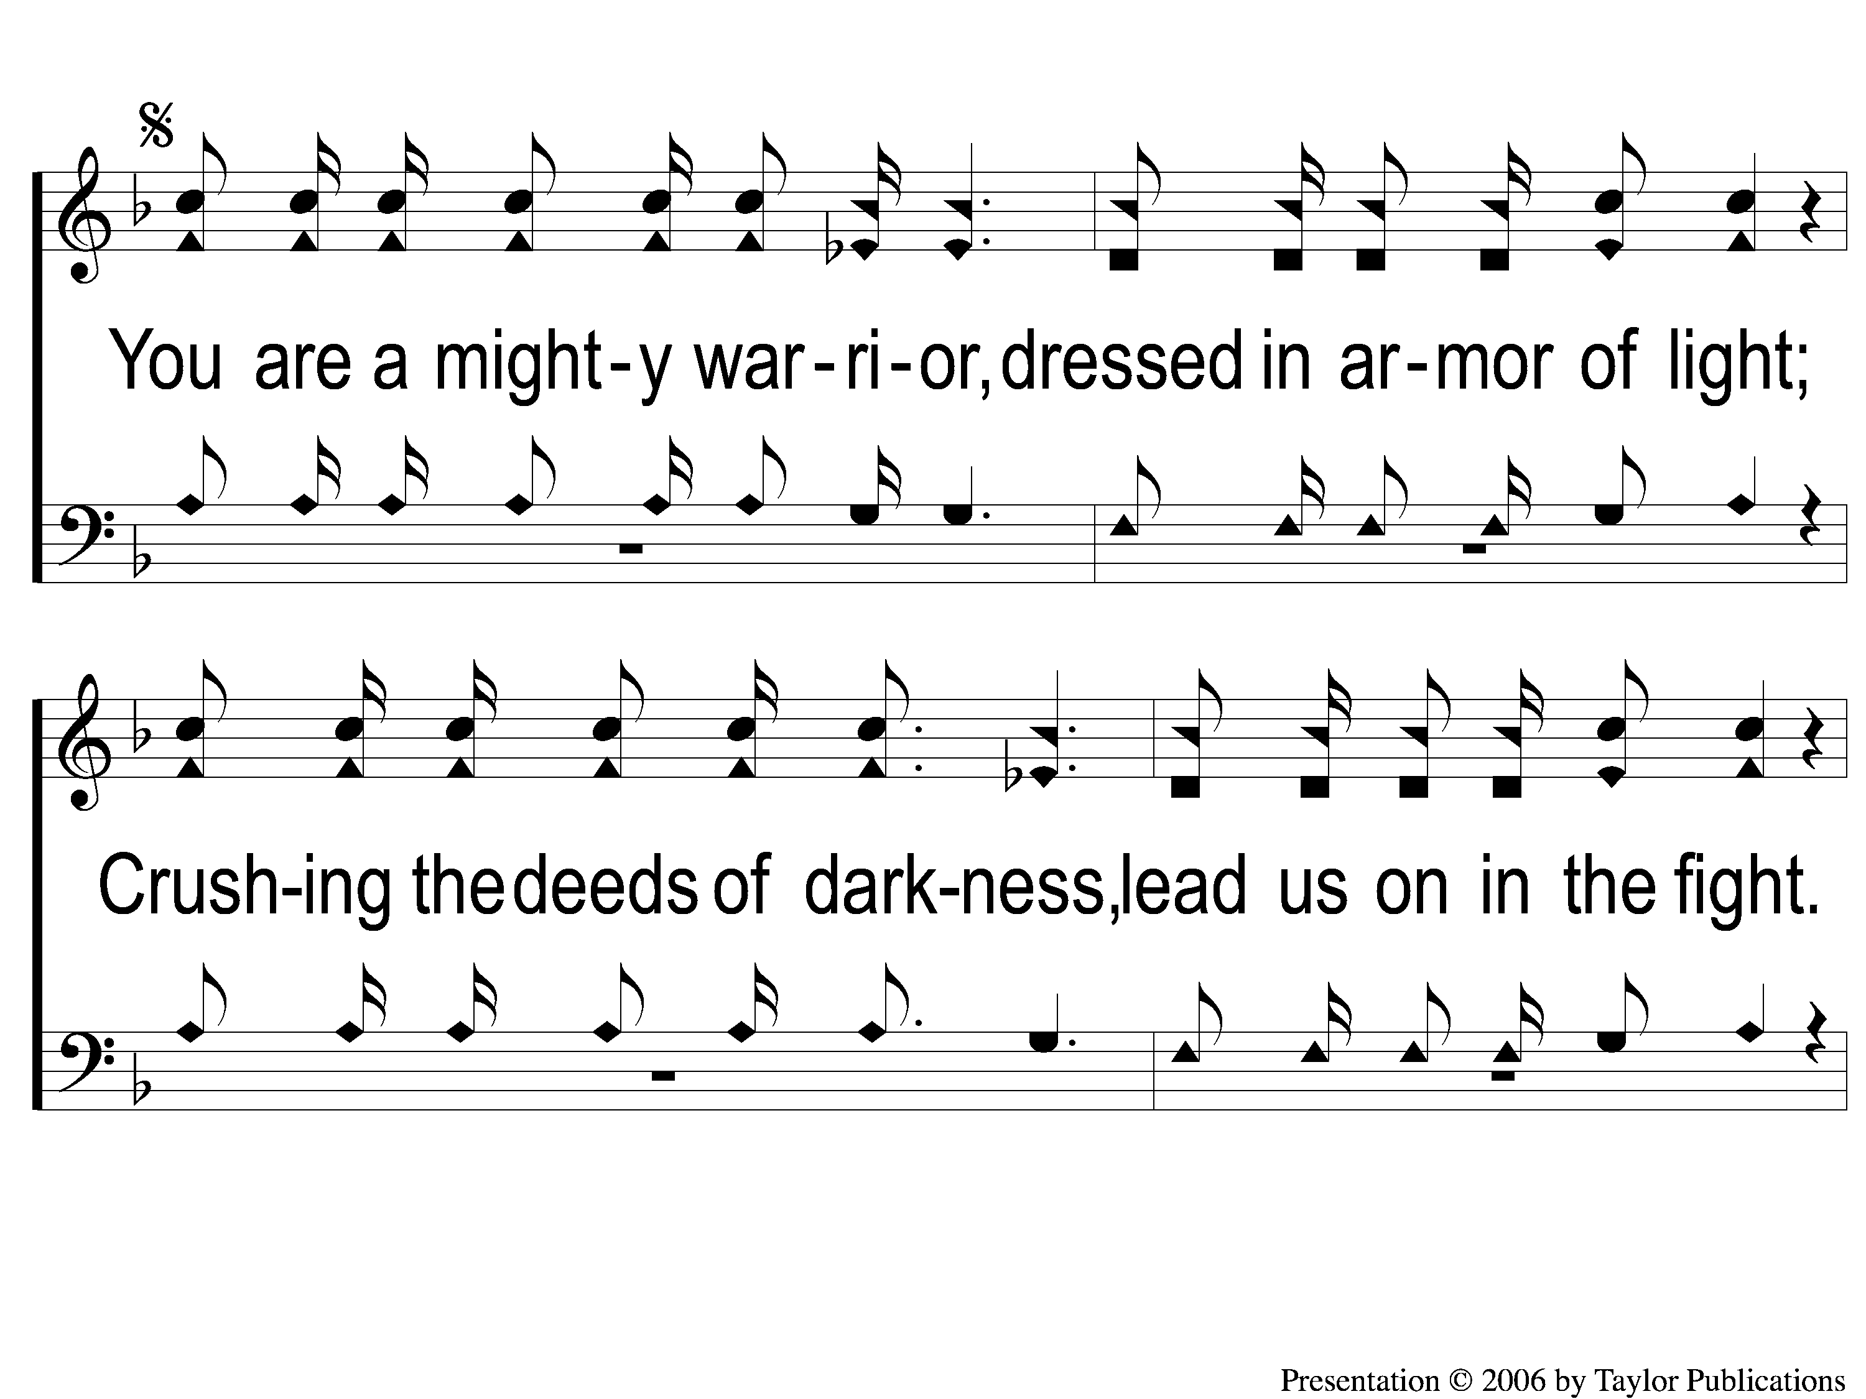
Ds-1 Above All Else
Above All Else
171

Slide 10
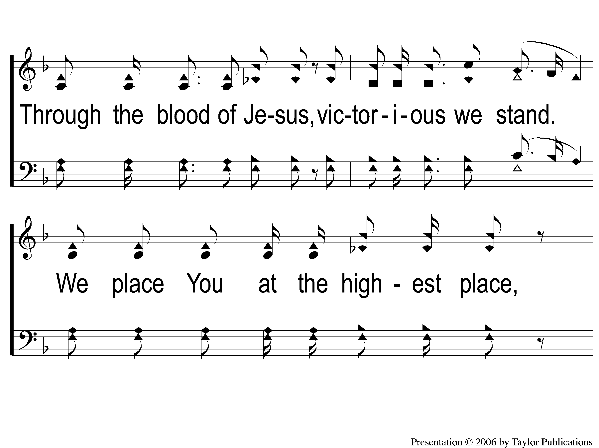
Ds-2 Above All Else
Above All Else
171

Slide 11
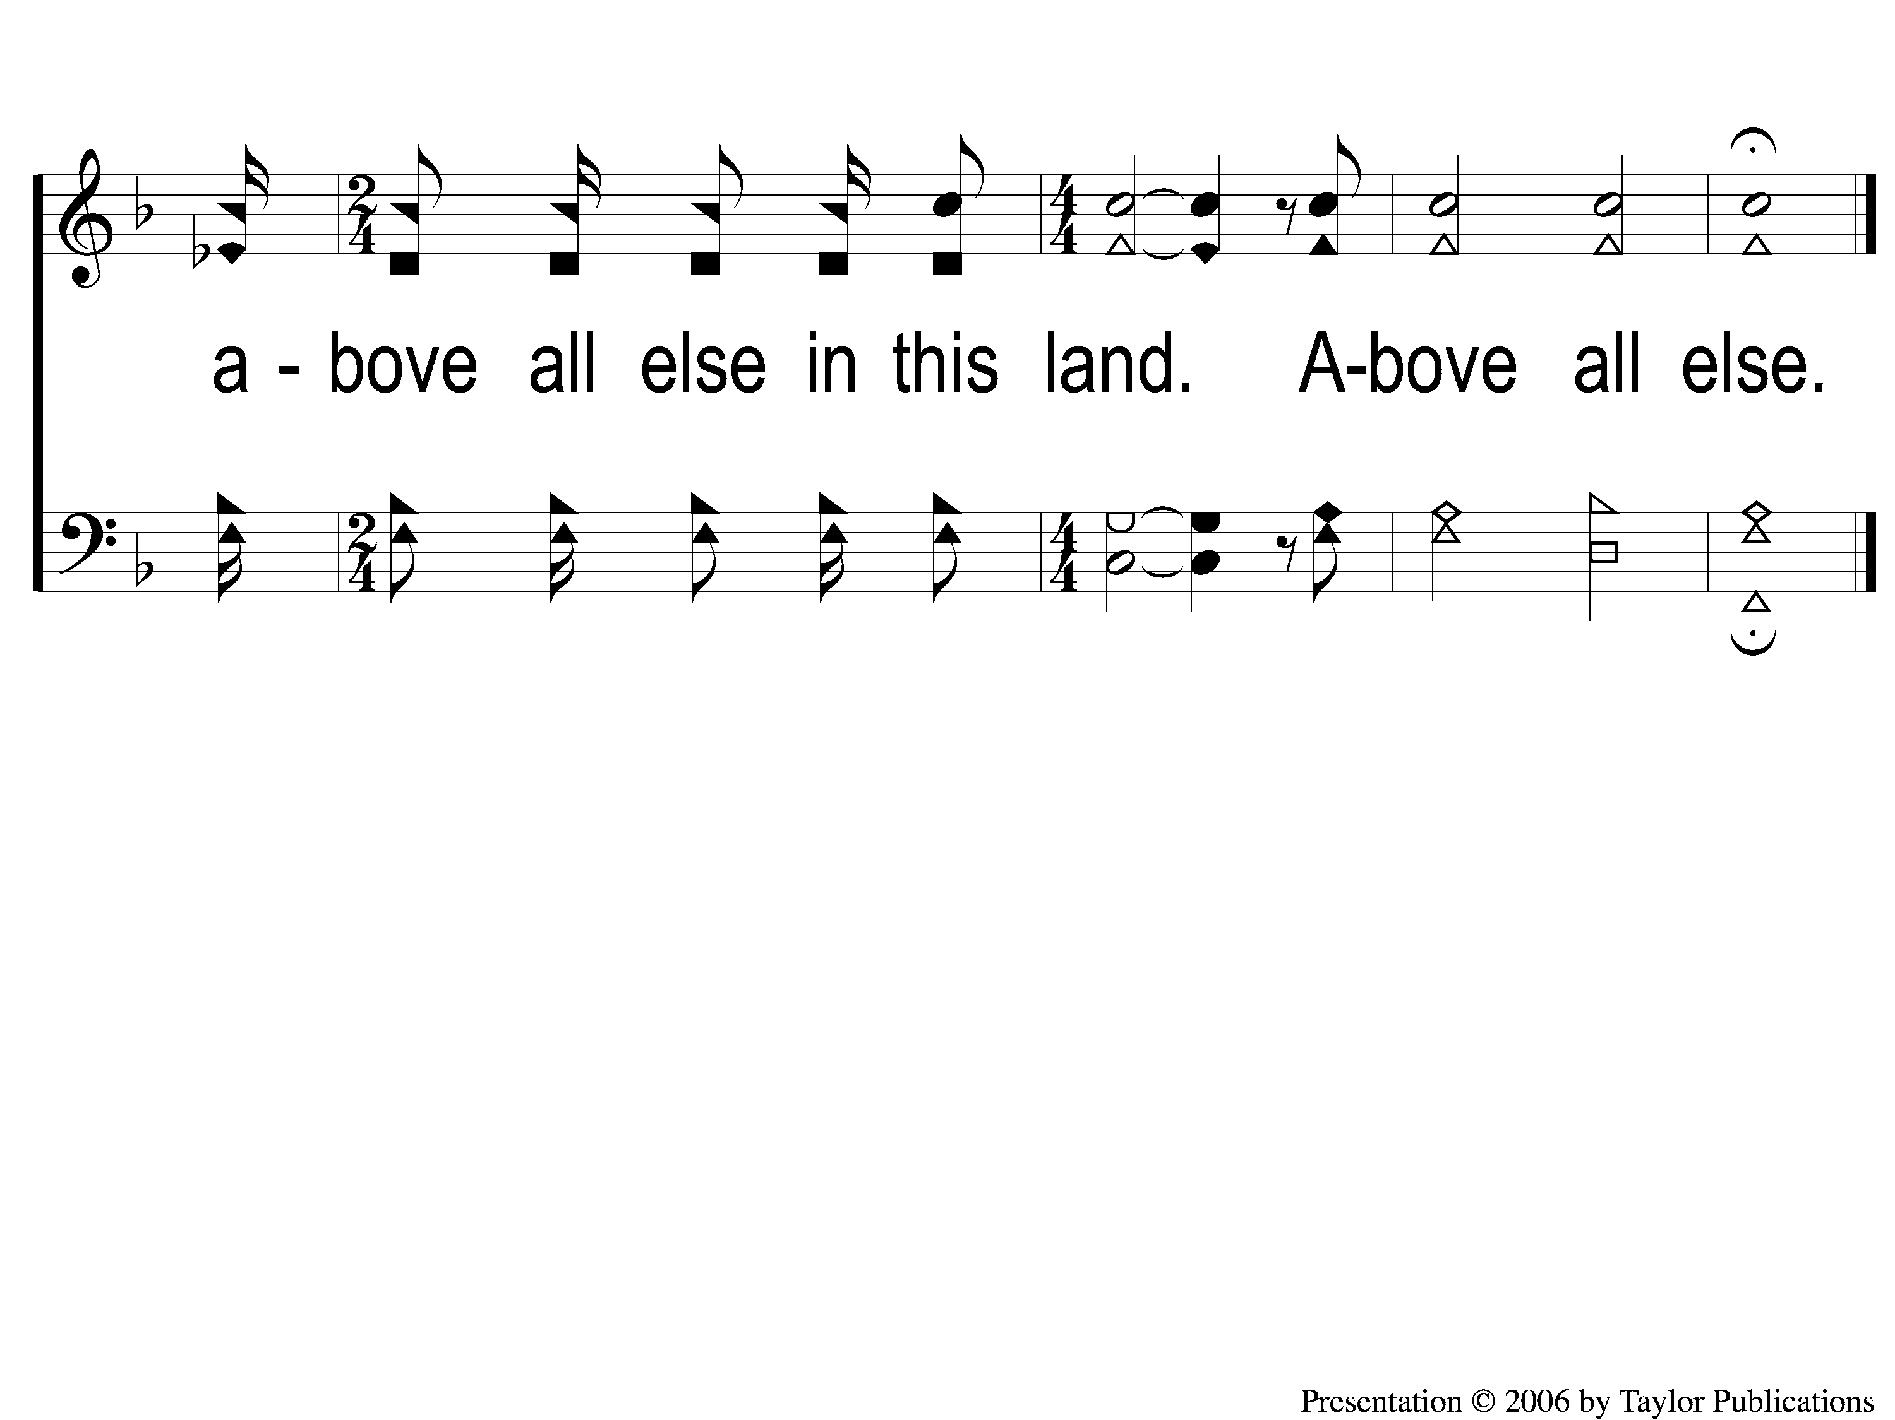
Ds-3-end Above All Else
Above All Else
171

